Slide 1
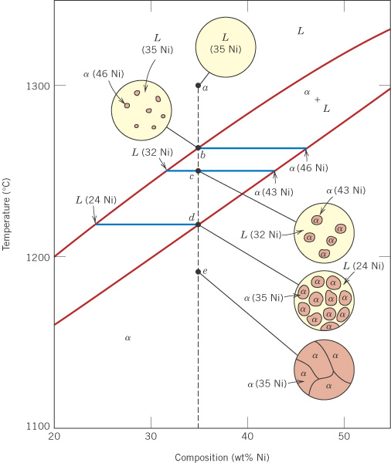
c10f04
3. Mass (weight) fractions
At (a) and (b): W_{L} = 1.00
At (d) and (e): W_{α} = 1.00
At (c), for the two phases,
L (32% Ni) and α (43% Ni):
R
S
L
32
(c)
35
α
43
%Ni
 Cu
Ni 

Slide 2
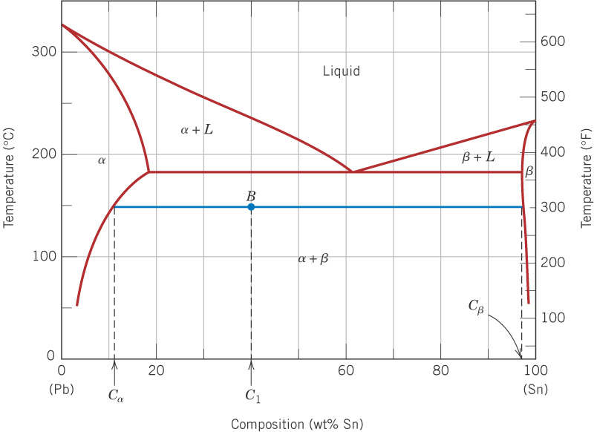
c10f09
Examples 9.2 and 9.3(a)
For 40 wt% Sn - 60 wt% Pb
at 150°C, find:
Phases present:
(1) α is Pb-rich SS
(2) β is Sn-rich SS
11
98
Phase compositions, wt%:
α has 11% Sn, 89% Pb
β has 98% Sn, 2% Pb
40
Weight (mass) fractions:

Slide 3
c10f09
Examples 9.2 and 9.3(a)
For 40 wt% Sn - 60 wt% Pb
at 150°C, find:
Phases present:
(1) α is Pb-rich SS
(2) β is Sn-rich SS
11
98
Phase compositions, wt%:
α has 11% Sn, 89% Pb
β has 98% Sn, 2% Pb
40
Weight (mass) fractions:
0.33
0.67
α
β
11
40
98

Slide 4
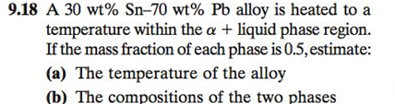
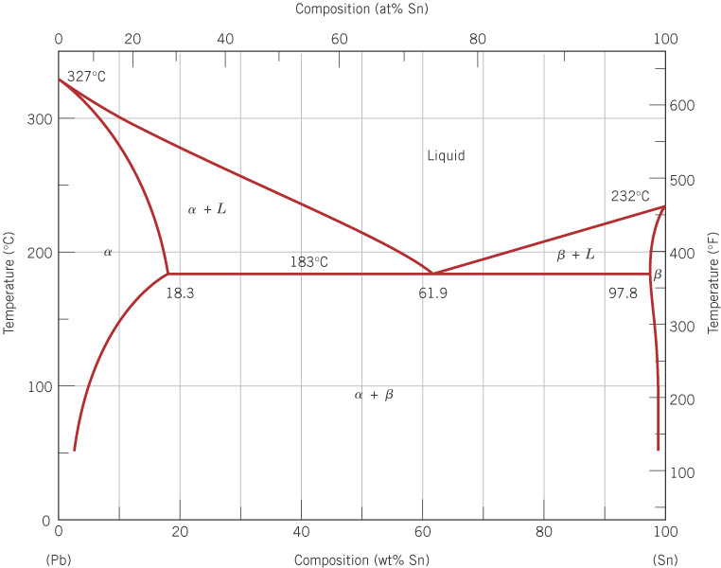

Slide 7
Microstructure

Slide 8
c10f08
Pb-Sn phase diagram – Let’s take a look at microstructure

Slide 9
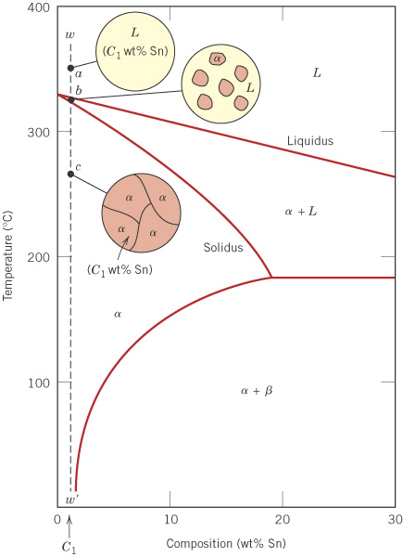
c10f11
Pb-Sn - single phase case
For a sufficiently small wt% Sn,
the solubility limit will never be
exceeded, so that a single phase alloy results.
Pb

Slide 10
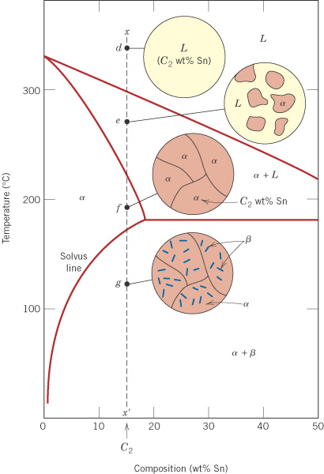
c10f12
Pb-Sn - simple
two-phase case
(no eutectic)
For larger wt% Sn, the solubility limit is exceeded on cooling, so that a two-phase material results.
Pb

Slide 11
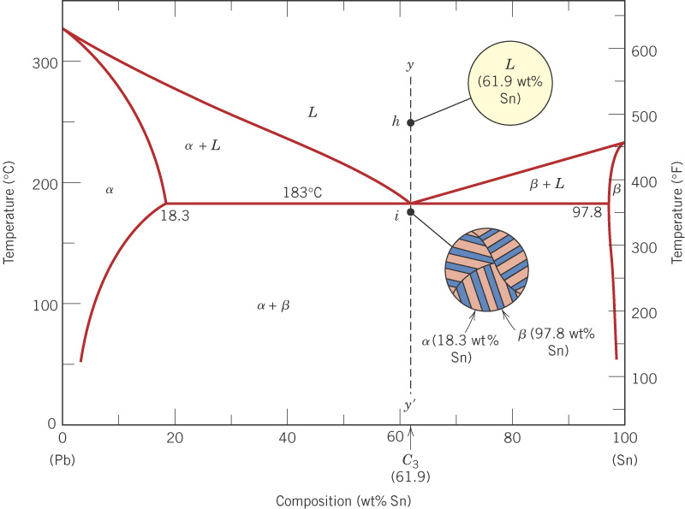
c10f13
Pb-Sn eutectic
For 61.9 wt% Sn, a layered eutectic structure is formed.
eutectic point
A
B
A-B is the eutectic line

Slide 12
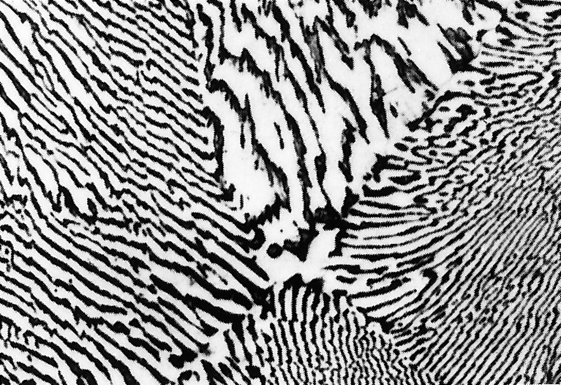
c10f14
Pb-Sn eutectic
The dark areas are Pb-rich α solid solution, and the light areas are Sn-rich β solid solution.
375X

Slide 13
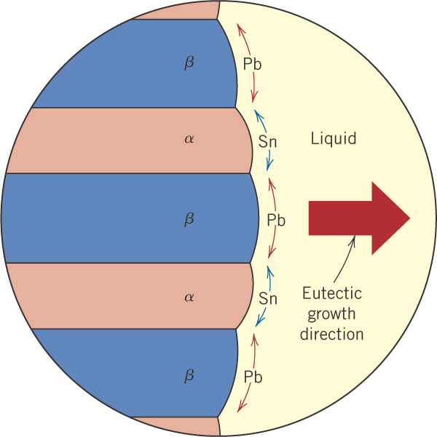
c10f15
Eutectic structure forms only from the liquid phase
82 wt% Pb
98 wt% Sn

Slide 14
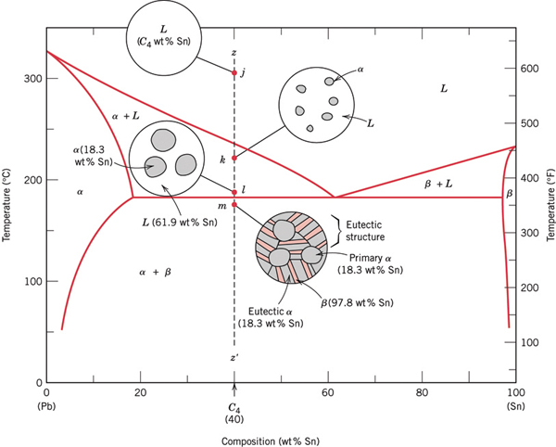
If we drop below 183 C, the L will transform into the eutectic structure, but we already have some α formed in the α + L region above 183 C.
Pb-Sn eutectic
plus primary α

Slide 15
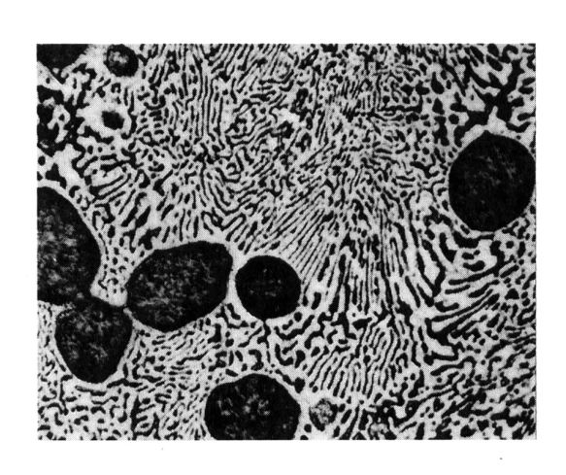
Pb-Sn eutectic
plus primary α
dark areas = Pb-rich α solid solution
light areas = Sn-rich β solid solution.
Eutectic α
dark
Eutectic β
α’
light
400X
Eutectic structure

Slide 16
Mass fractions of microconstituents – Eutectic System

Slide 17
Pb-Sn eutectic
plus primary α
dark areas = Pb-rich α solid solution
light areas = Sn-rich β solid solution.
Eutectic α
dark
Eutectic β
α’
light
400X
Eutectic structure

Slide 18
If we drop below 183 C, the L will transform into the eutectic structure, but we already have some α formed in the α + L region above 183 C.
Pb-Sn eutectic
plus primary α

Slide 19
Calculation of fractions of alpha & beta in final microstructure

Slide 20
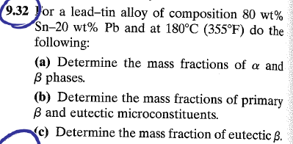
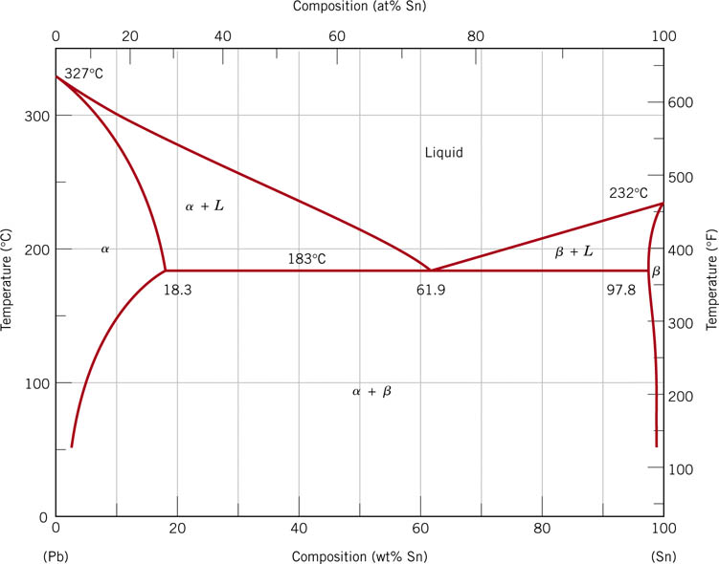
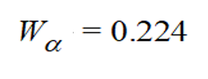
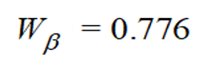




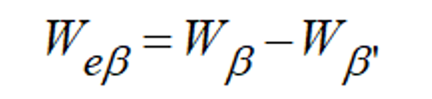

See if you can repeat the calculations for a composition greater than 61.9 wt%
Answers:

Slide 21
The End

